Slide 1


Learn to program
Python
William Hartemink, Hazem Hassan
October 17, 2018

Slide 2
Why Learn to Program?

Slide 3
Why Learn to Program?
Skills are in-demand

Slide 4
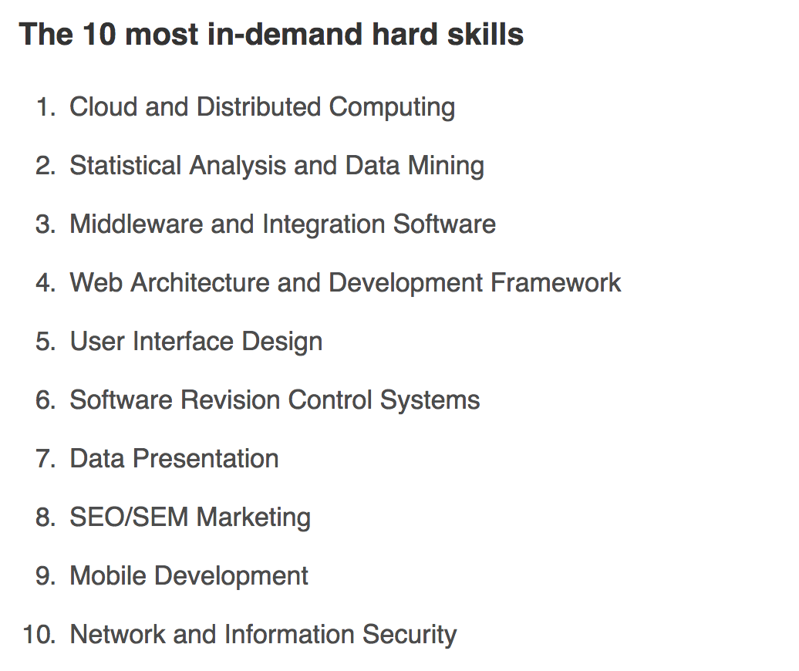


Slide 6
Programming can be personally useful

Slide 7
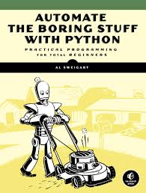
Programming can be personally useful

Slide 8
Stuff that we’ll automate?

Slide 9

Stuff that we’ll automate?

Slide 10


Stuff that we’ll automate?

Slide 11


Stuff that we’ll automate?

Slide 12
Why Learn to Program?
Skills are in-demand
Programming is personally useful

Slide 13
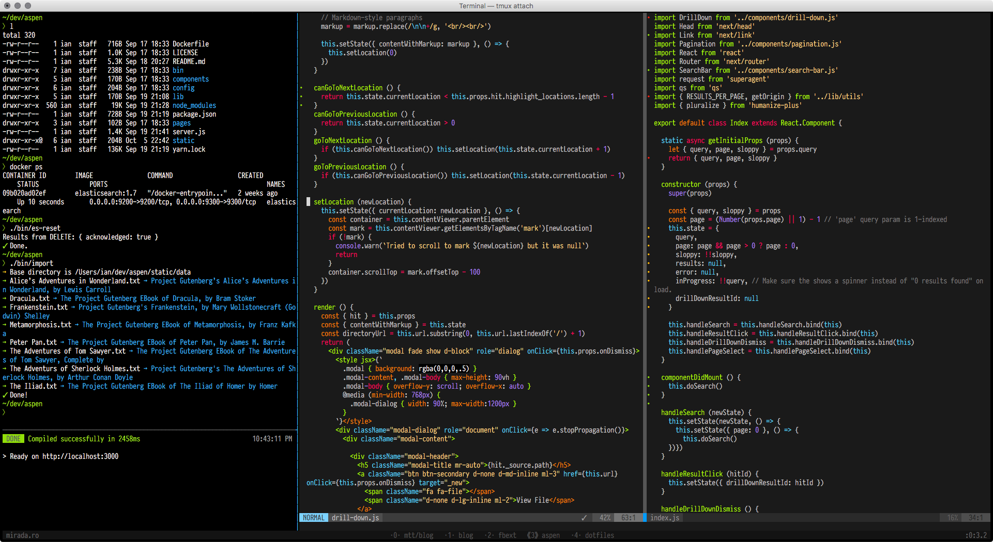
Is it true that you have to start from a very young age?

Slide 14
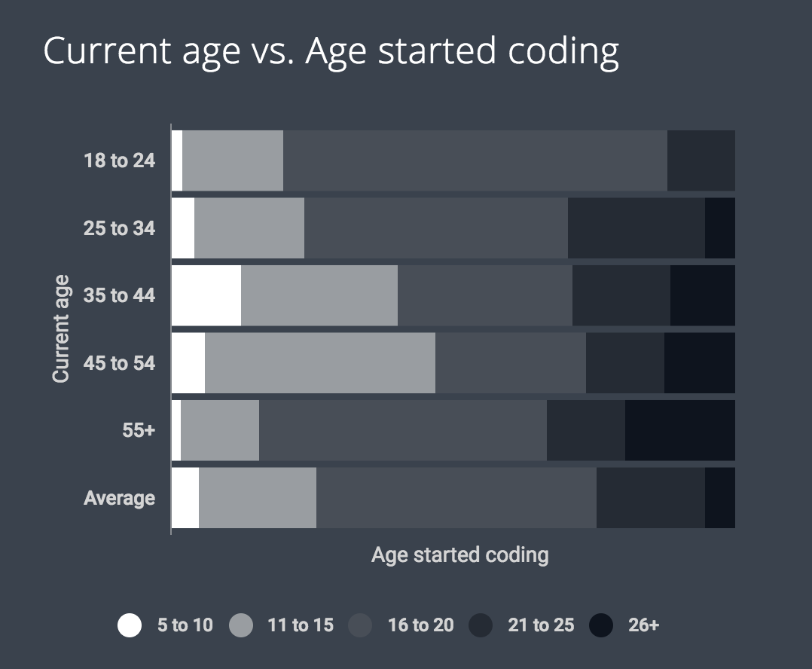

Slide 15
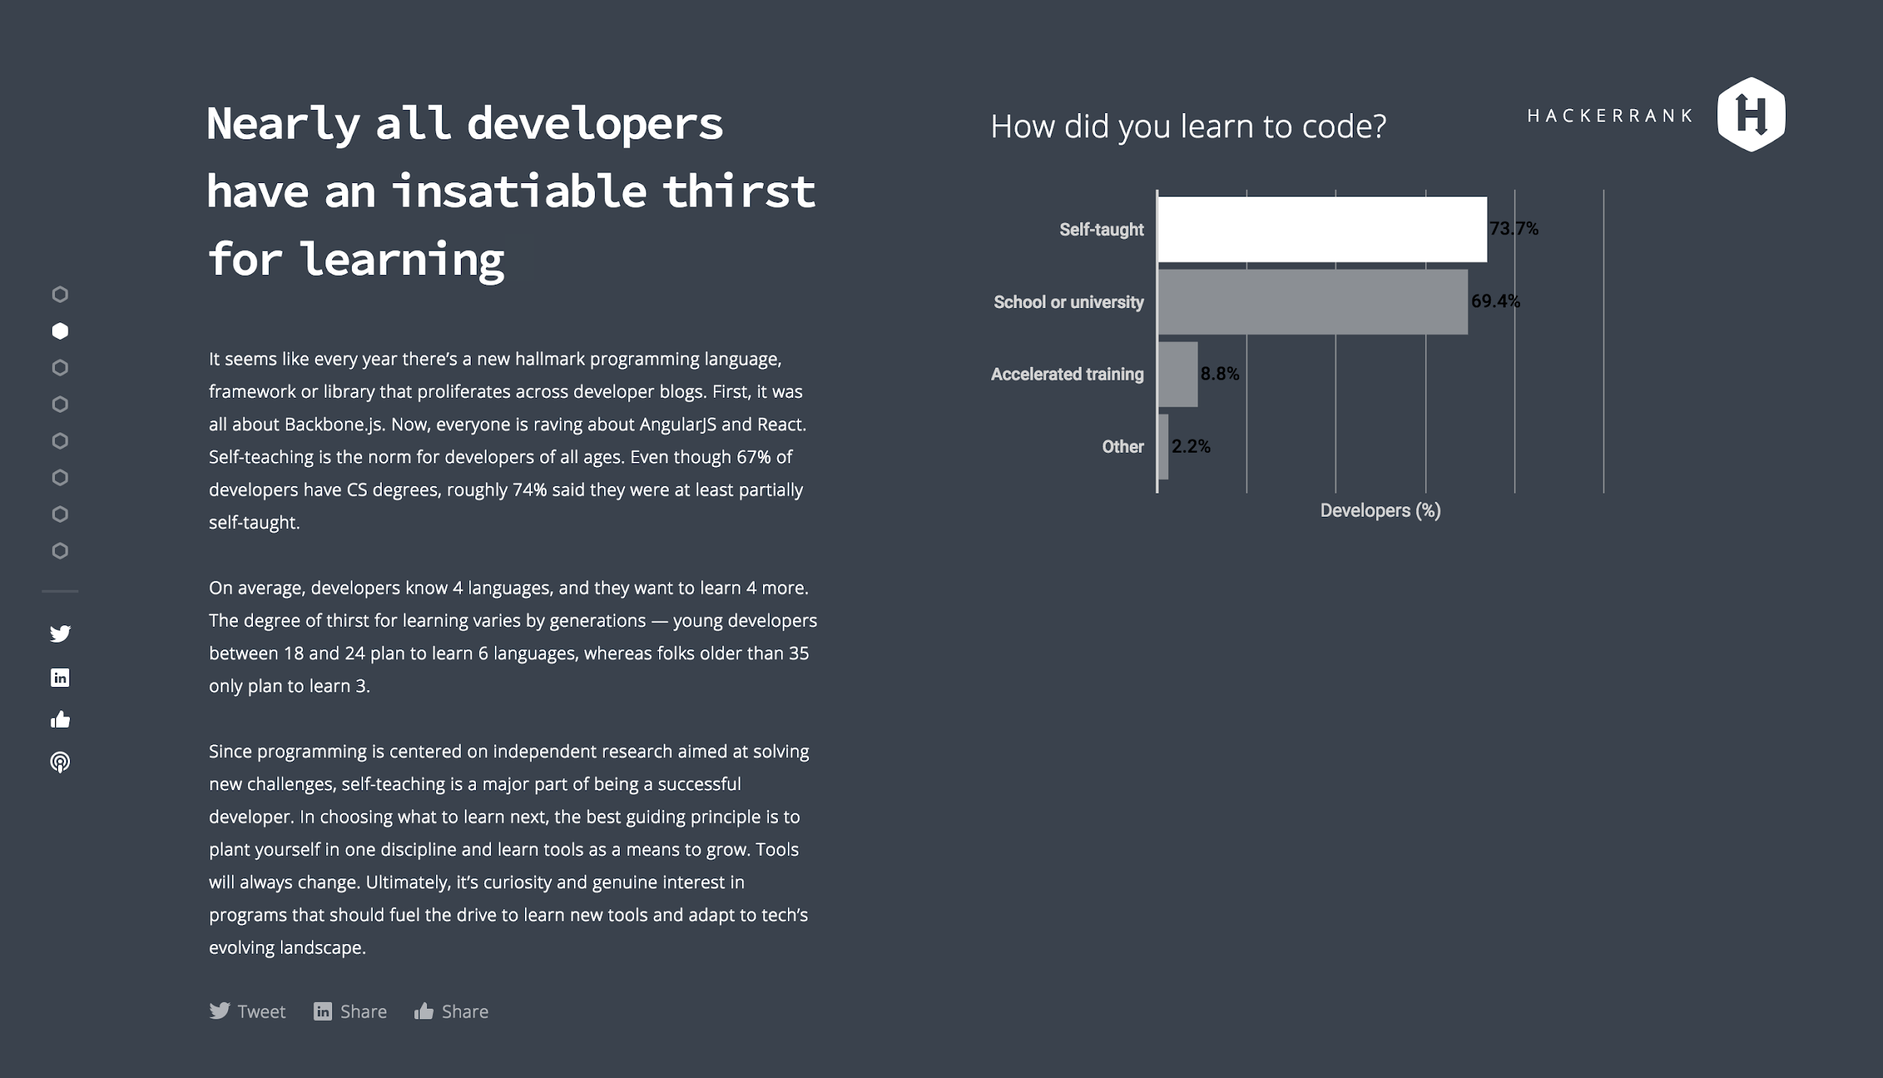

Slide 16
Why Learn to Program?
Skills are in-demand
Programming is personally useful
University age is a great time to start

Slide 17
Understanding
Programming Languages

Slide 18

Communication

Slide 19
“Please leave the room"

Slide 20


Slide 23


Slide 24
1 Instruction
“Please leave the room"

Slide 25
1 Instruction, (Many substeps)
Find the door
Walk to the Door
Open the door
Go through it
Close the door behind you

Slide 26
1 Instruction, (Many substeps)
Find the door
Look around the room
If you see a door, remember where it is and move onto the next step
Repeat the above until you see a door
Walk to the Door
Decide on a path to walk to the door (shortest path without walking into obstacles preferred)
Follow the chosen path
If an obstacle appears, such as another person, find a new path
Move onto the next step when you are within a meter of the door
Open the door
Is there “Push” or “Pull” written anywhere? If so, follow that instruction
If there are no written instructions, observe the ergonomics of the door.
Does it make more sense to push or pull?
Do you remember entering? No? Well try everything you can in this order: Push, Pull, slide to the right, up, push again, pull again, look around and see if anyone is judging you. Think about how pathetic it is that opening a door could even possibly be this hard. Give your best puppy dog eyes to the nearest student in hopes that they’ll put you out of your misery with some vague hand gestures that signal to you how the door works.
Go through the door
Close the door behind you

Slide 27
“Please leave the room"
Find the door
Look around the room
If you see a door, remember where it is and move onto the next step
Repeat the above until you see a door
Walk to the Door
Decide on a path to walk to the door (shortest path without walking into obstacles preferred)
Follow the chosen path
If an obstacle appears, such as another person, find a new path
Move onto the next step when you are within a meter of the door
Open the door
Is there “Push” or “Pull” written anywhere? If so, follow that instruction
If there are no written instructions, observe the ergonomics of the door.
Does it make more sense to push or pull?
Do you remember entering? No? Well try everything you can in this order: Push, Pull, slide to the right, up, push again, pull again, look around and see if anyone is judging you. Think about how pathetic it is that opening a door could even possibly be this hard. Give your best puppy dog eyes to the nearest student in hopes that they’ll put you out of your misery with some vague hand gestures that signal to you how the door works.
Go through the door
Close the door behind you

Slide 28

“Please leave the room"
Find the door
Look around the room
If you see a door, remember where it is and move onto the next step
Repeat the above until you see a door
Walk to the Door
Decide on a path to walk to the door (shortest path without walking into obstacles preferred)
Follow the chosen path
If an obstacle appears, such as another person, find a new path
Move onto the next step when you are within a meter of the door
Open the door
Is there “Push” or “Pull” written anywhere? If so, follow that instruction
If there are no written instructions, observe the ergonomics of the door.
Does it make more sense to push or pull?
Do you remember entering? No? Well try everything you can in this order: Push, Pull, slide to the right, up, push again, pull again, look around and see if anyone is judging you. Think about how pathetic it is that opening a door could even possibly be this hard. Give your best puppy dog eyes to the nearest student in hopes that they’ll put you out of your misery with some vague hand gestures that signal to you how the door works.
Go through the door
Close the door behind you

Slide 29
Humans
Understand Context
Use Common Sense
Computers
Don’t understand context
Can’t use common sense

Slide 30
Humans
Understand Context
Use Common Sense
Computers
Don’t understand context
Can’t use common sense

Slide 31


Slide 32
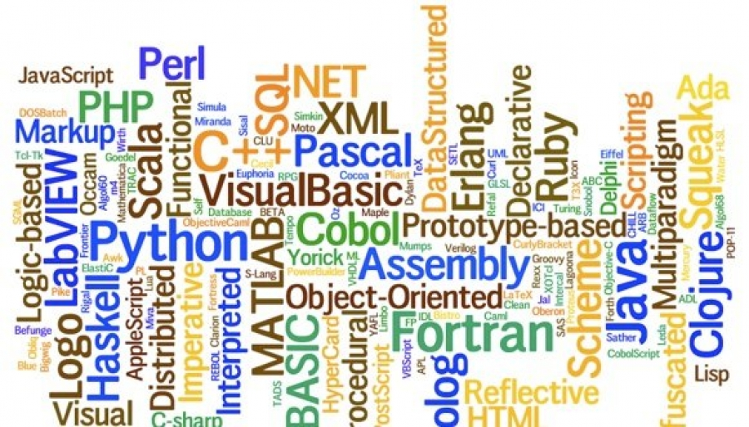

Slide 33
Machine Code
[Essentially Binary]
Human Language
MATLAB
R
Javascript
Python
Ruby
Java
C#
C++
C
Assembly Language

Slide 34
Machine Code
[Essentially Binary]
Human Language
MATLAB
R
Javascript
Python
Ruby
Java
C#
C++
C
Assembly Language

Slide 35
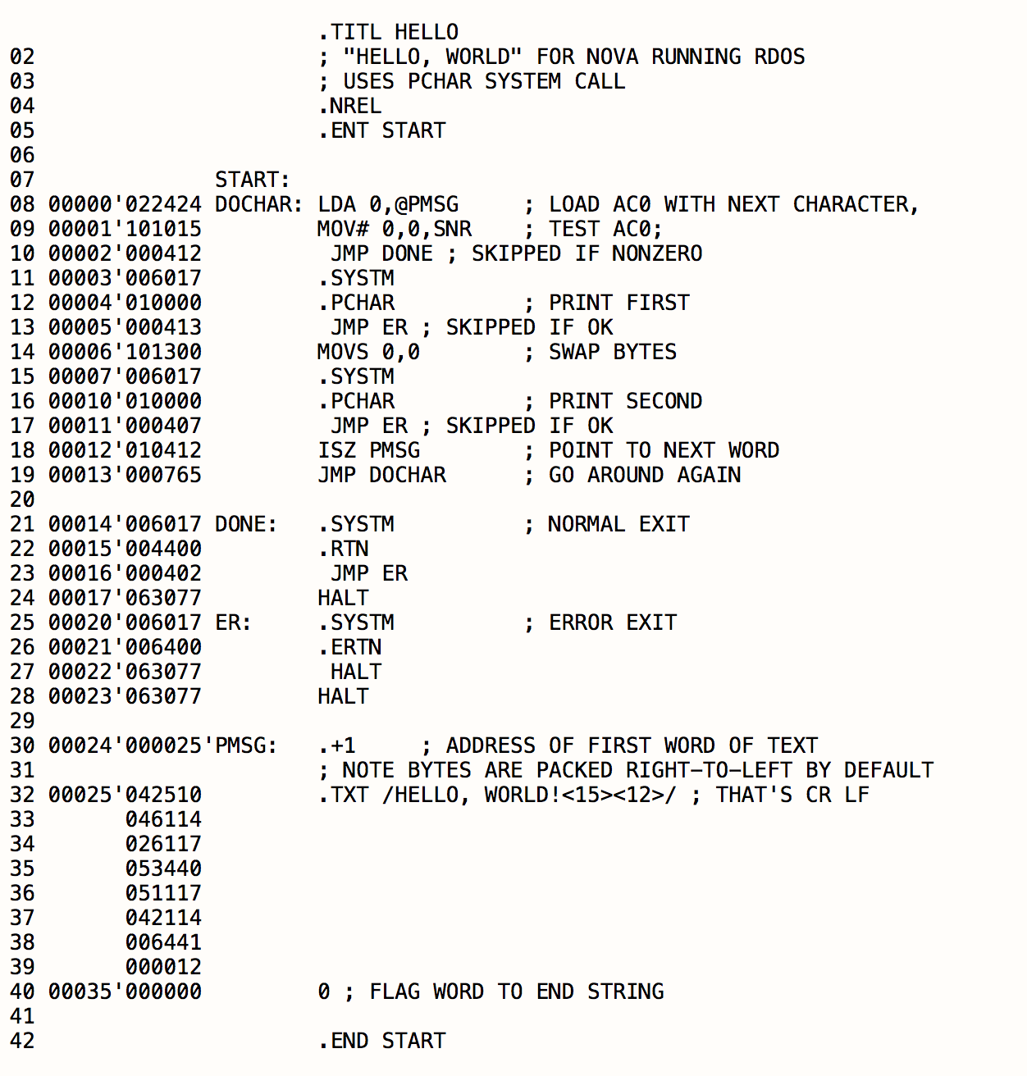
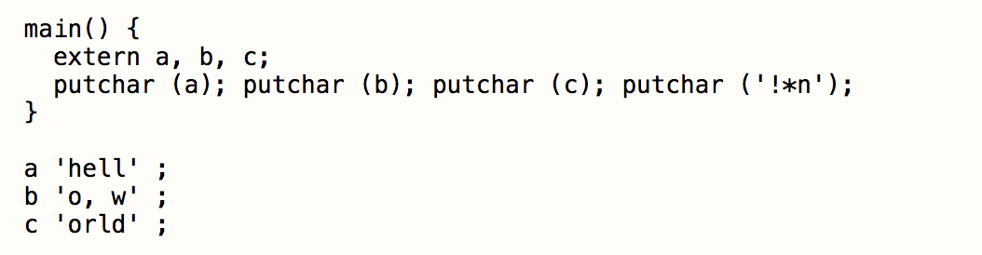
Assembly (invented 1949)
B (invented 1969)

Slide 36
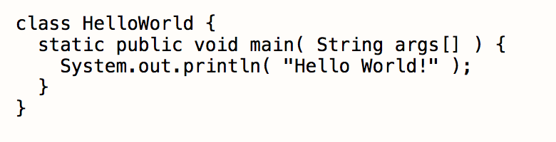
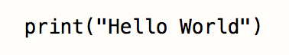
Java (1991)
Python (1990)

Slide 37
print(“hello world”)
Does a whole lot of things

Slide 38
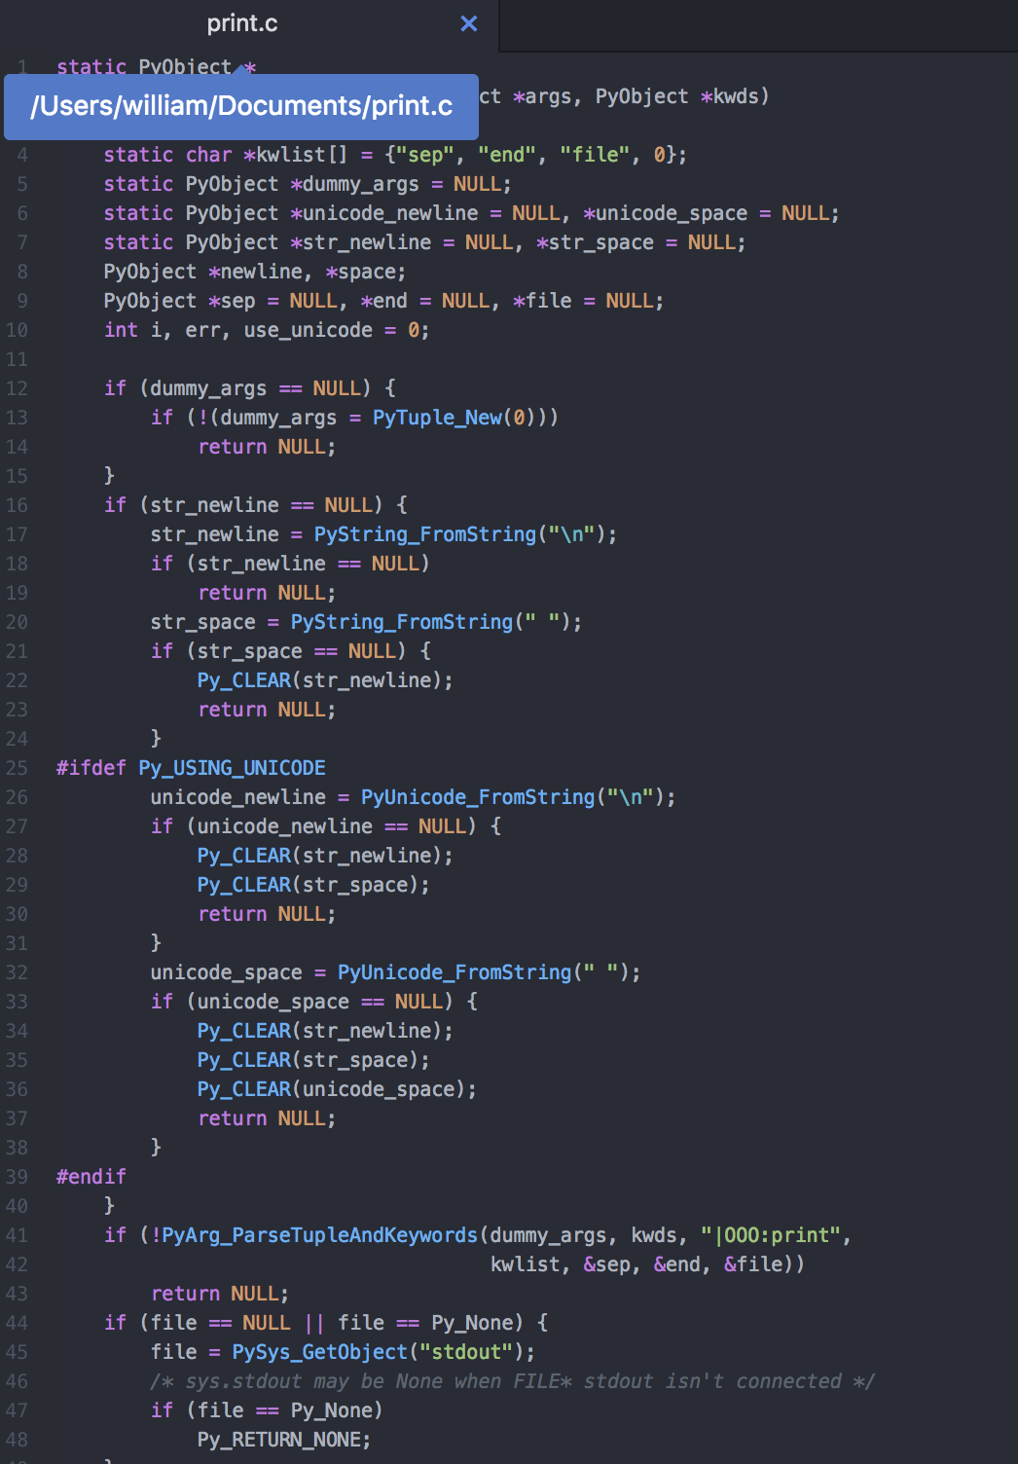
120 lines of code (in C)
print(“hello world”)
Does a whole lot of things
And that doesn’t really matter to us

Slide 39
120 lines of code (in C)
print(“hello world”)
Does a whole lot of things
People are building tools like these every day!

Slide 40
Why Learn to Program?
Skills are in-demand
Programming is personally useful
University age is a great time to start
Programming is more accessible than ever

Slide 41
Why Python?

Slide 42
Why Python?
Good First programming language

Slide 43
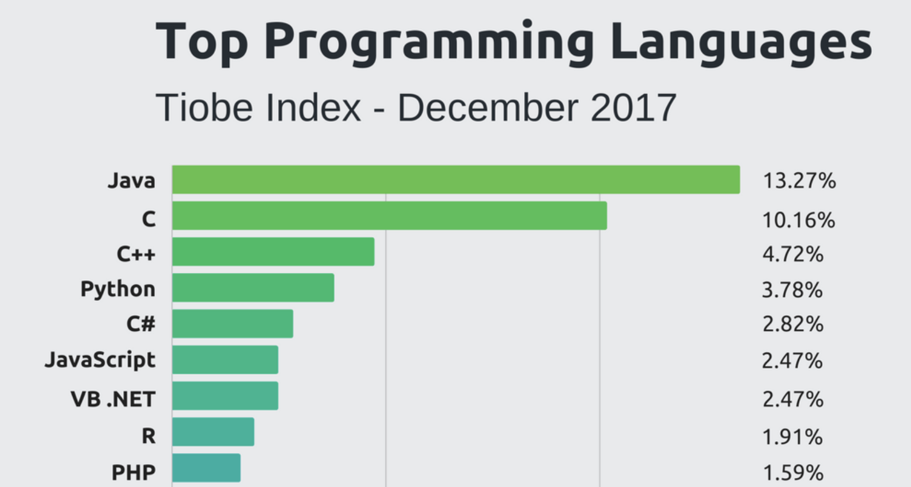
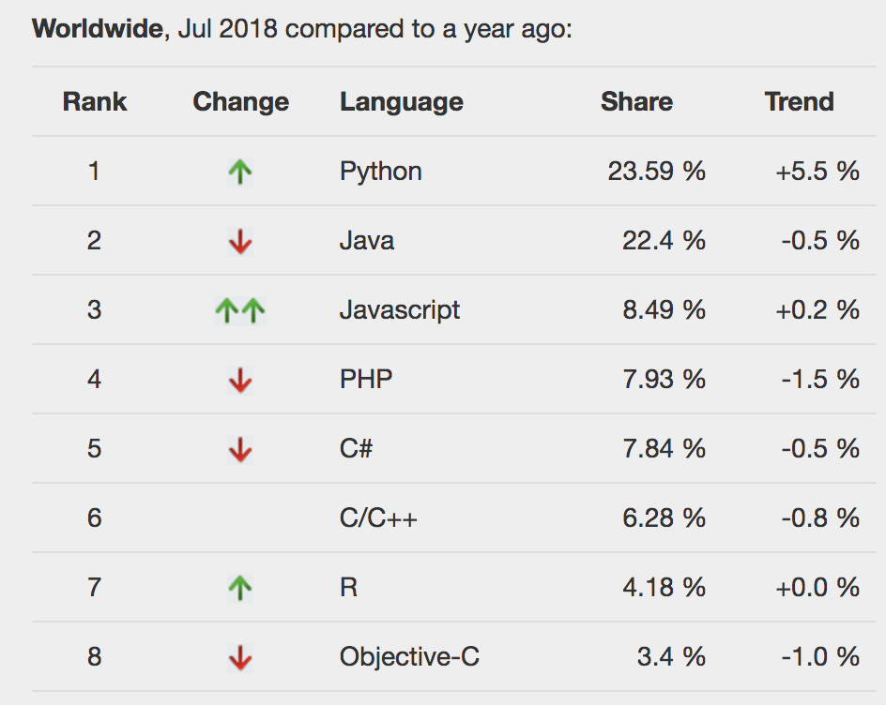
Consistently Popular

Slide 44
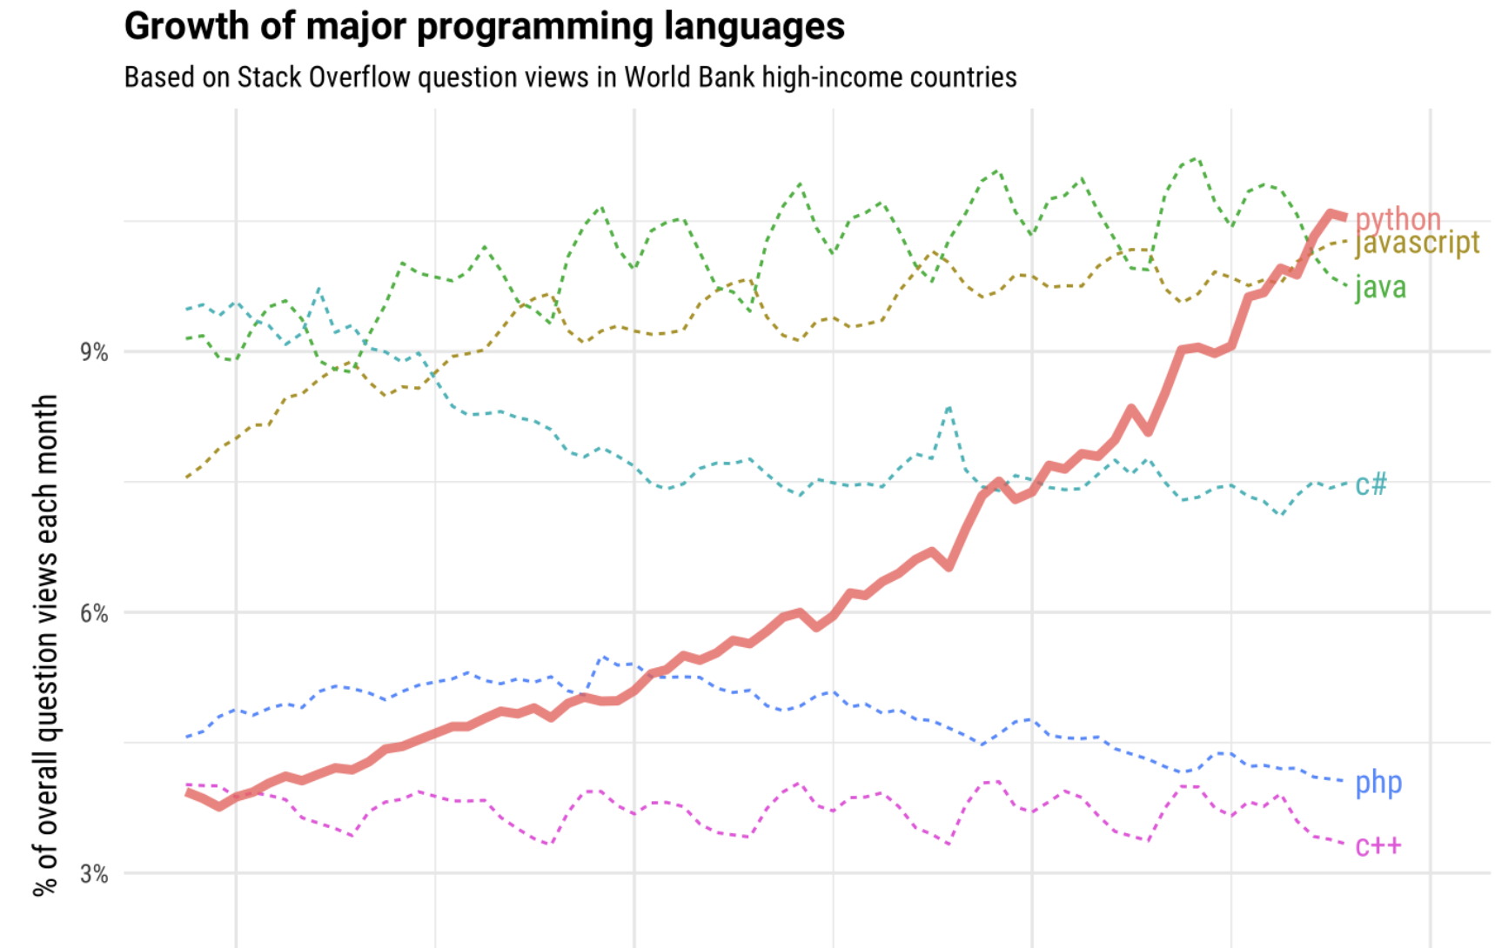
Consistently Popular

Slide 45
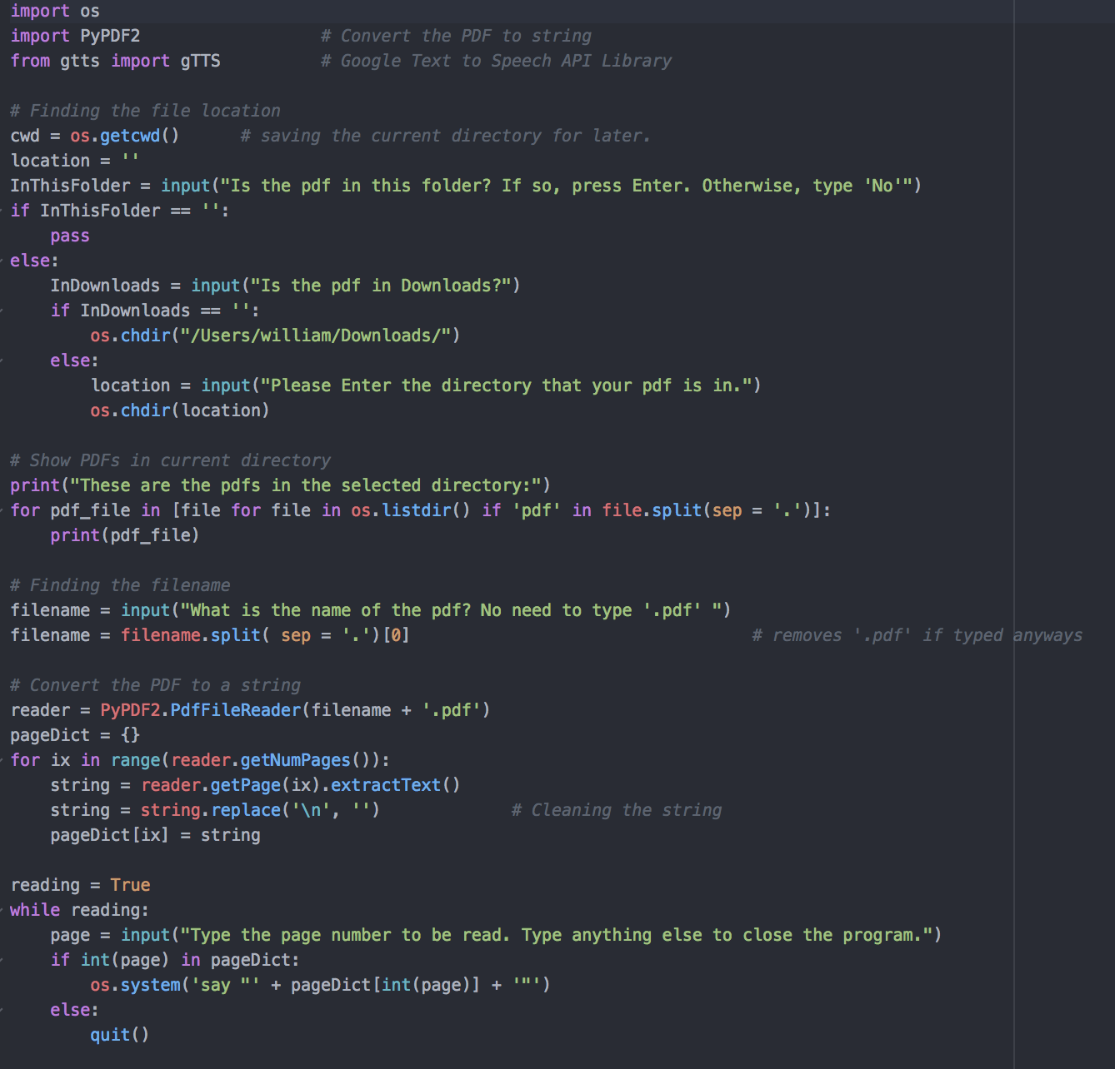
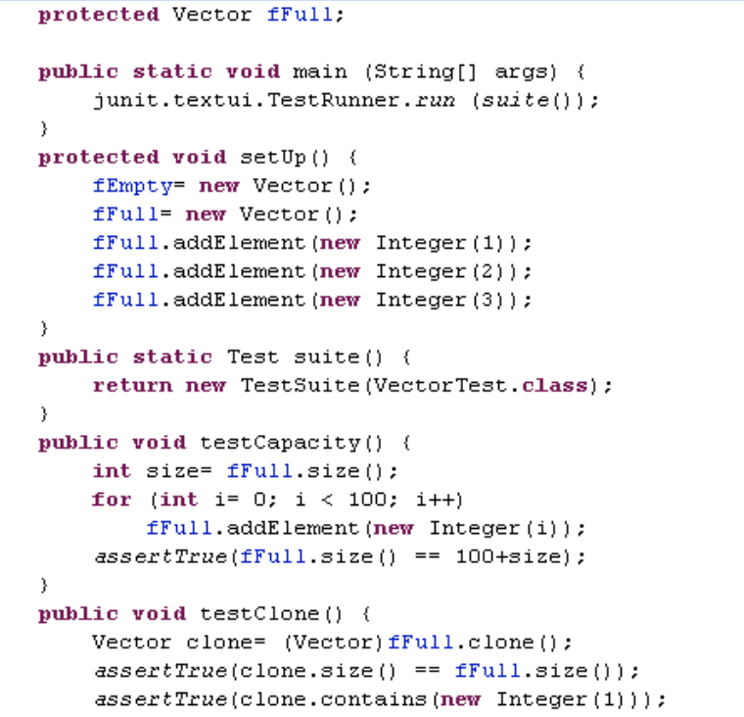
Easy to Read

Slide 46
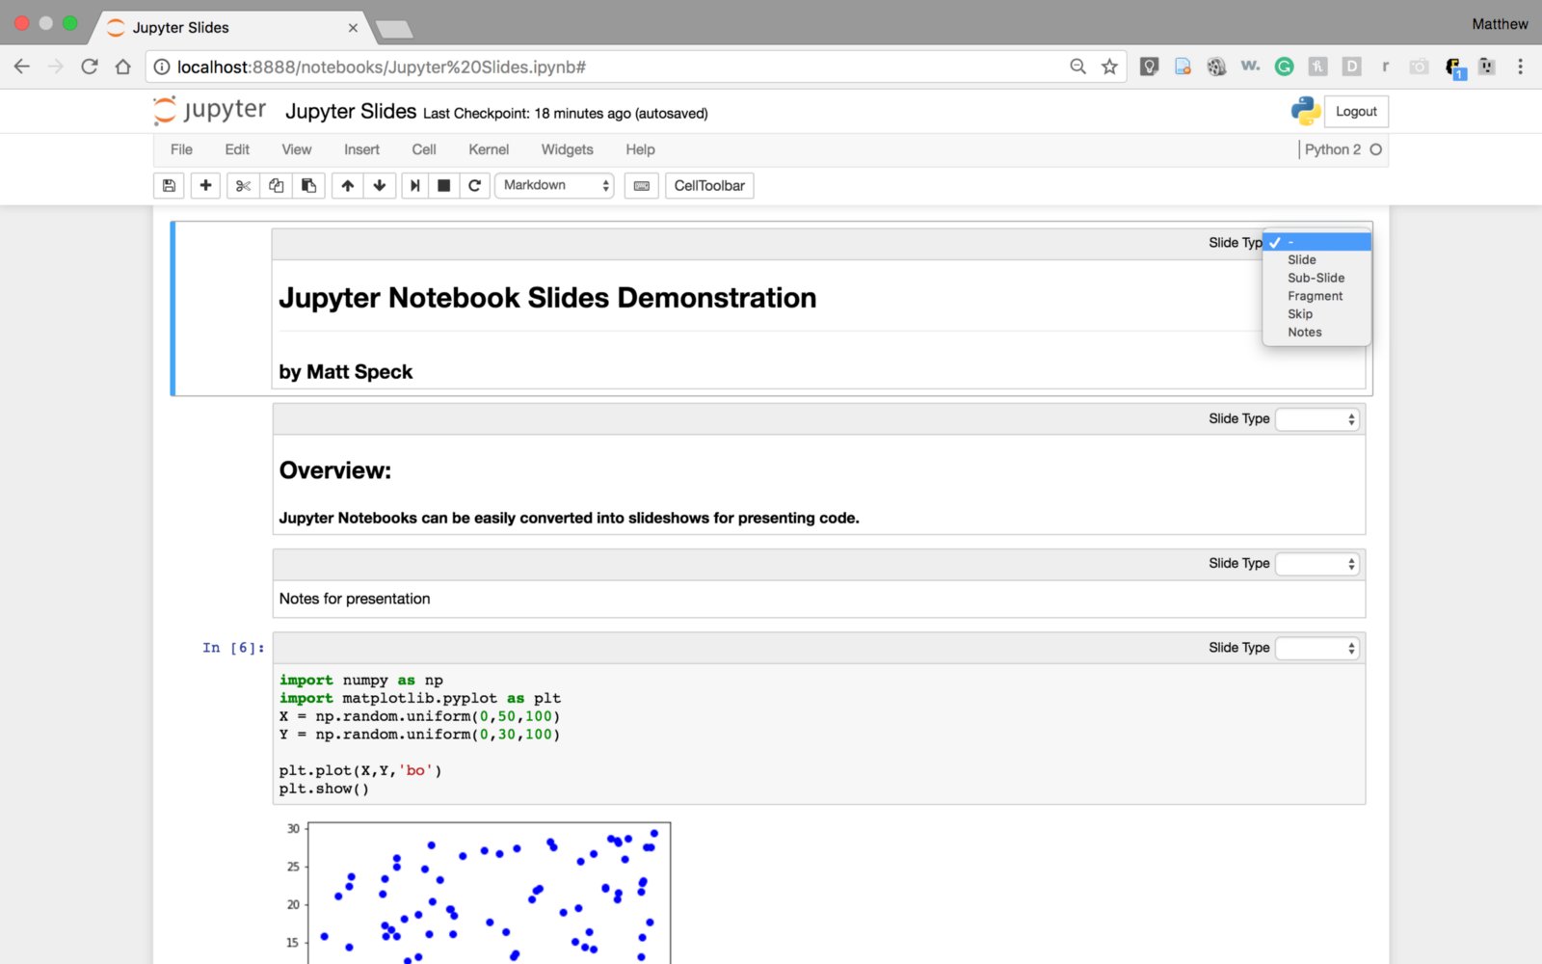
Easy to Write

Slide 47
Loads of tools (libraries, packages)

Slide 48
Loads of tools (libraries, packages)
Open up terminal, and type:
>>>conda list
To see how many you have

Slide 49
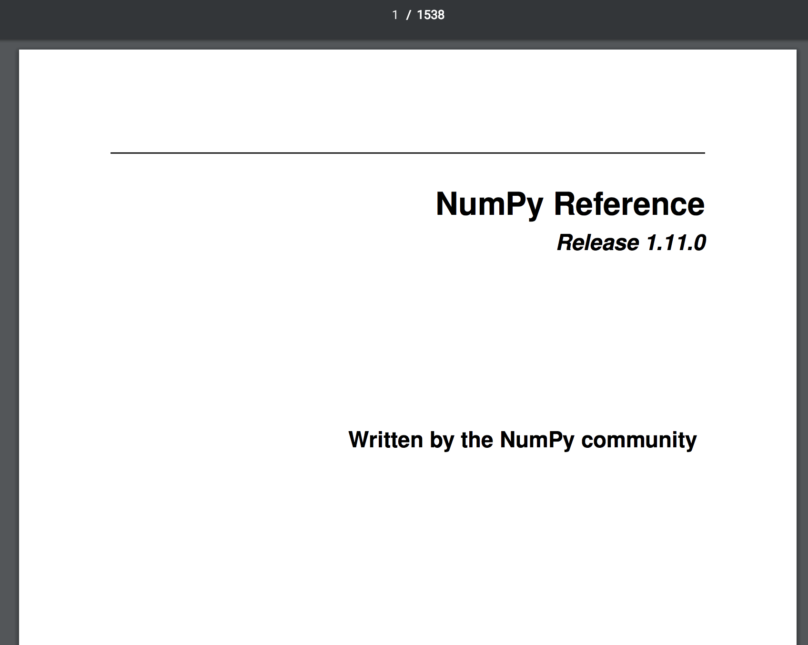

Slide 50


Slide 51
Python is open-source!
It’s free to use, unlike MATLAB

Slide 52
Why Python?
Good First programming language
Easy to Read
Easy to Write
Loads of Tools
Open-Source!

Slide 53
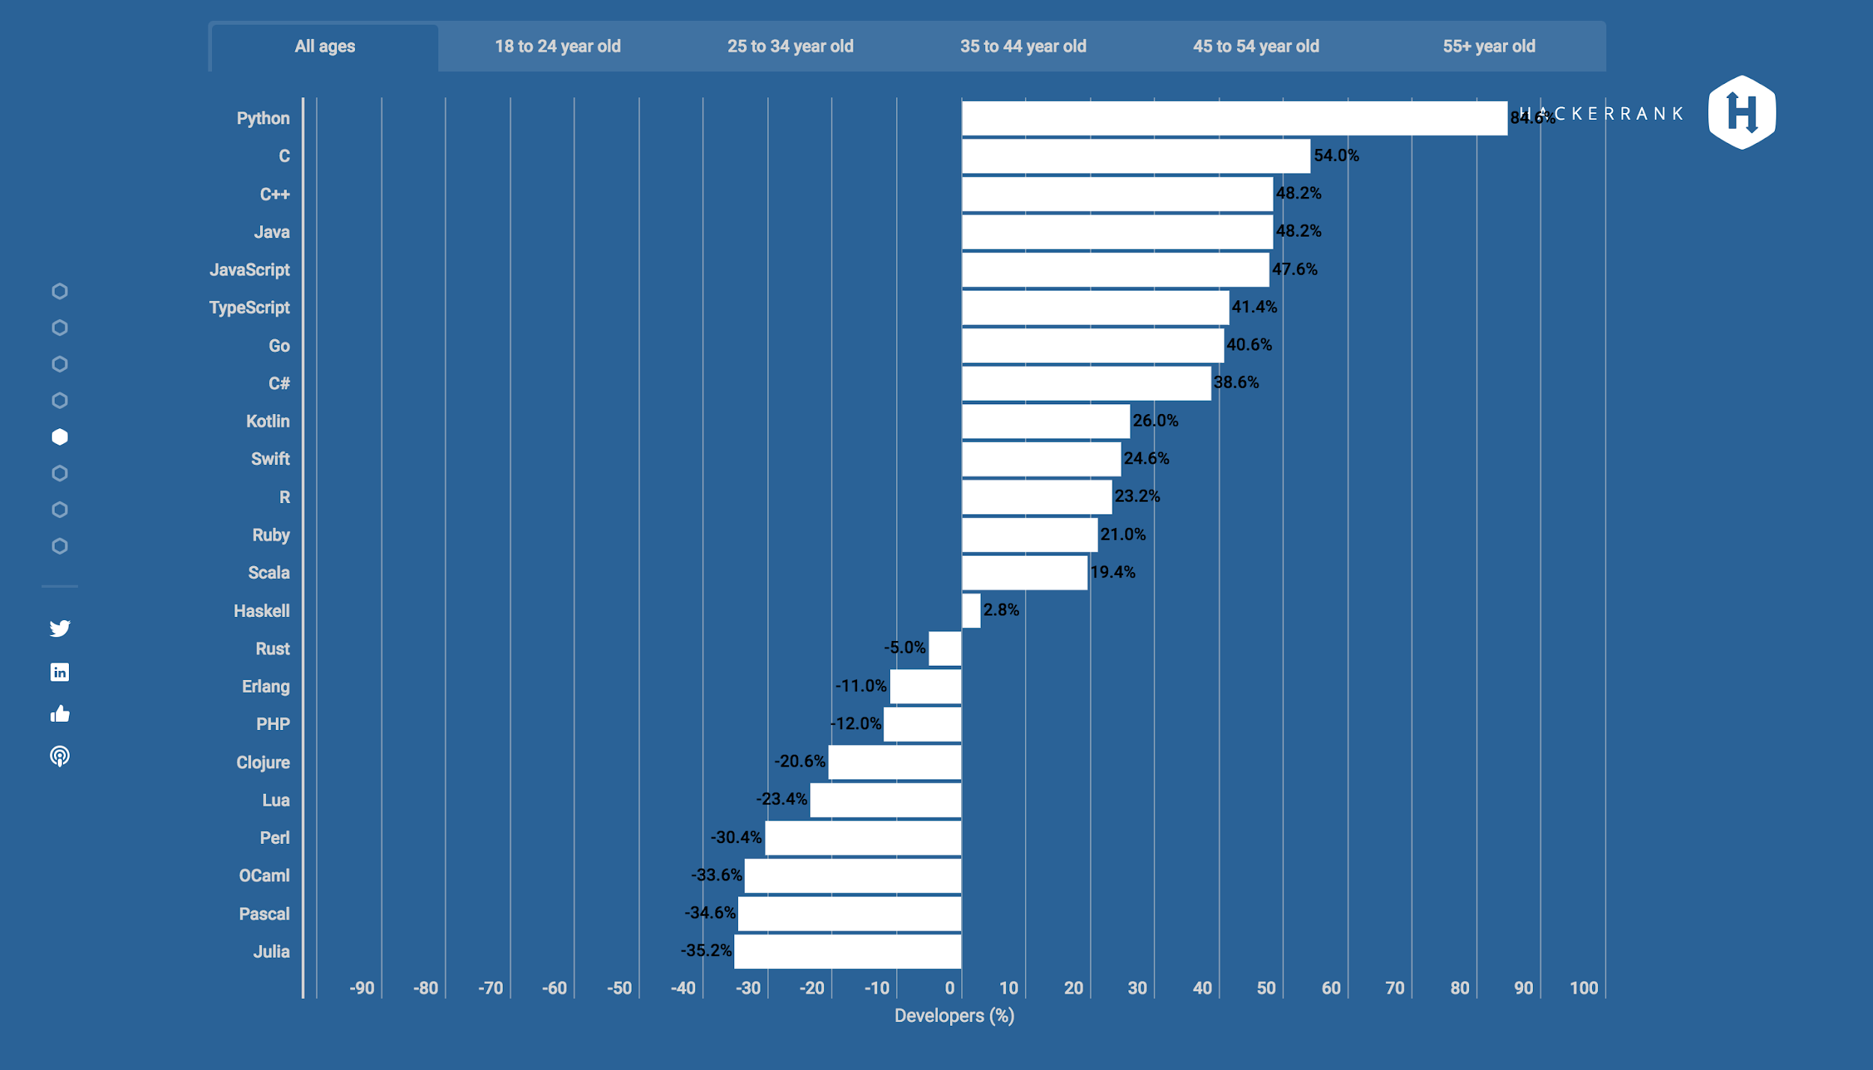
Python is a favorite <3
84.6% approval

Slide 54
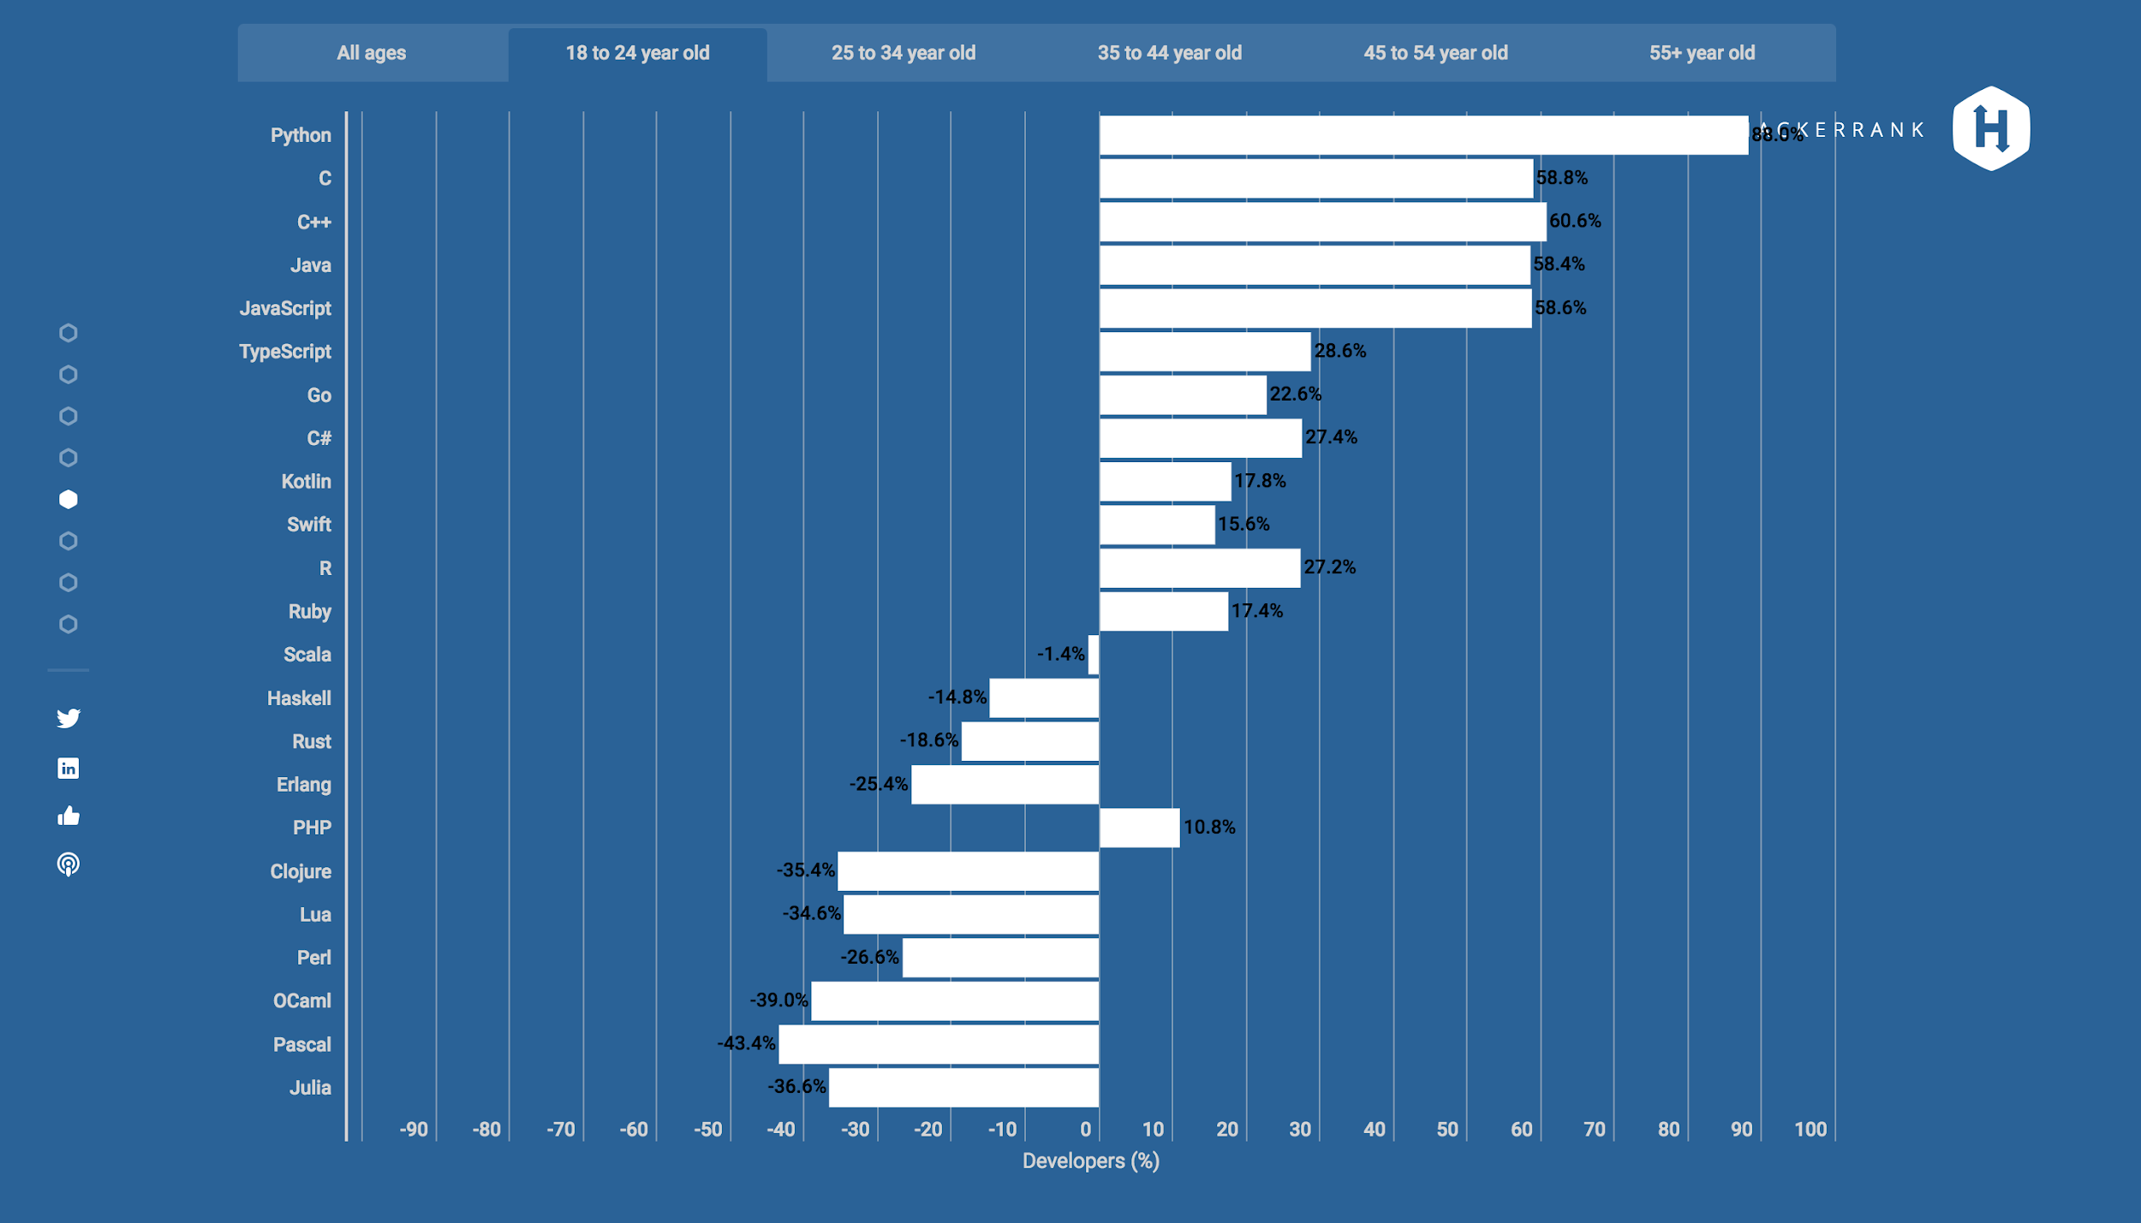
Especially to young people
88.0% approval

Slide 55
Course
Overview

Slide 56
-Python Basics (2 Sessions)
-Automating Email Sending (3rd Session) -Web Scraping and APIs (4th Session) -Object Orientation (5th Session) -A Taste of Data Science (6th Session)

Slide 57
-Python Basics (2 Sessions)
Using Python Like a Calculator
How Python works

Slide 58
-Automating Email Sending (3rd Session)
Send personalized emails to a list of a few hundred people

Slide 59
-Web Scraping + APIs (4th Session)
How to get data from websites to use in your own programs
(i.e. Weather, Crypto Prices, News)

Slide 60
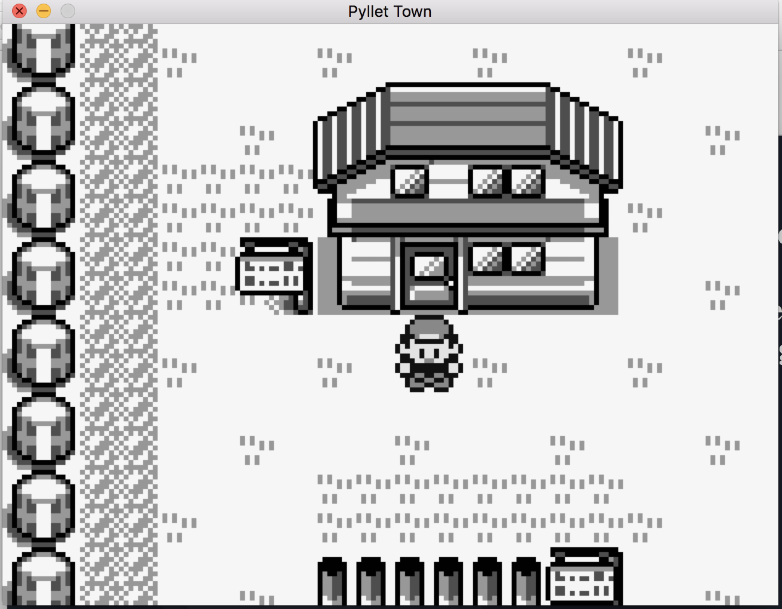
-Object Orientation (5th Session)
How to organize code to understand and build more complex programs (i.e. games)

Slide 61

-A Taste of Data Science (6th Session)
Using Pandas to play with csvs (way faster than Excel can :p )
Play with the MNIST digit dataset

